Slide 1

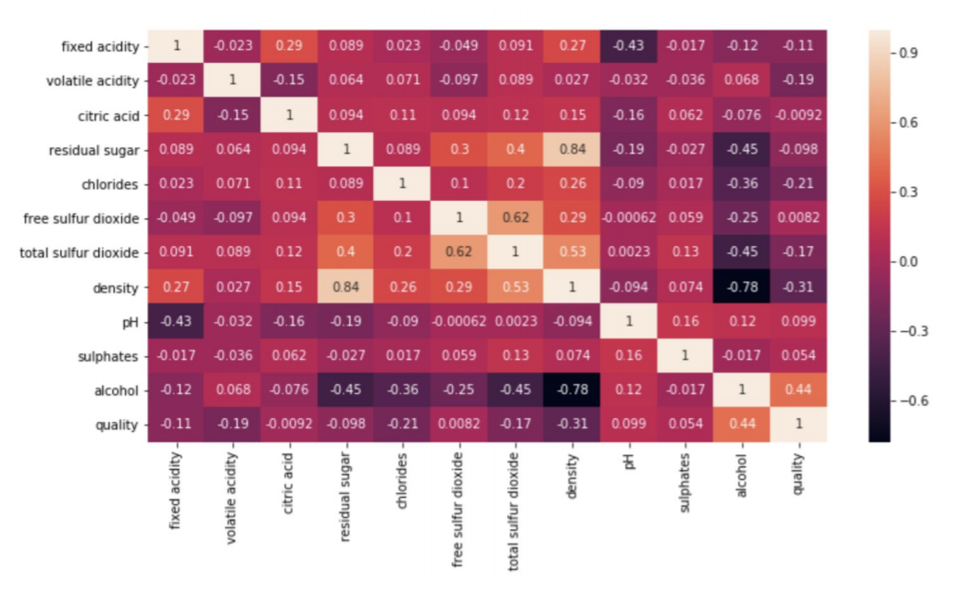

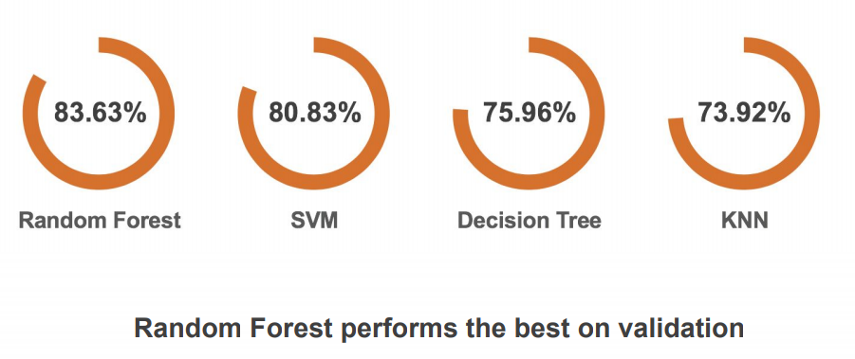
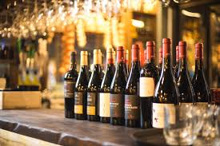
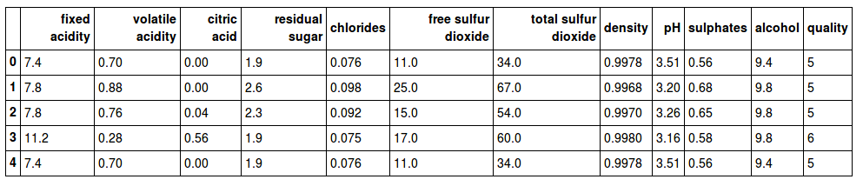
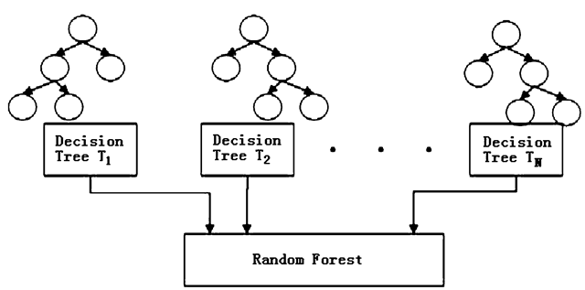
INSIGHTS FROM ANALYSIS
Characteristics
-Red wine or White wine
-High or low quality
Quality
on a scale of 1 to 10
-if >7 then Excellent,
-if in between 5&7 then Good,
-if <5 then it is Bad.
Ingredients which contribute more for type of the wine
- chlorides, sulphates, free sulfur dioxide, total sulfur dioxide, volatile acidity.
Ingredients which contribute more for quality of the wine
- Alcohol(major), density.
Data correlation matrix
Model:
we have used classification model to predict the quality of wine.
Predicting the quality of wine
summary
We have used different models and the outputs were like this
Project description
1,599 observations and 12 variables
Contains data on Red wine
The attributes are as follows
Team name: Techno Freaks
Fixed acidiy
Volatile acidity
Citric acid
Residual sugar
Chlorides
Free sulfur dioxide
Total sulfur dioxide
Density
pH
Sulphates
Alcohol
Project description
“Random forest classifier”
Model
Conclusion

Slide 3
Data correlation matrix
INSIGHTS FROM ANALYSIS
Characteristics
-Red wine or White wine
-High or low quality
Quality
on a scale of 1 to 10
-if >7 then Excellent,
-if in between 5&7 then Good,
-if <5 then it is Bad.
Ingredients which contribute more for type of the wine
- chlorides, sulphates, free sulfur dioxide, total sulfur dioxide, volatile acidity.
Ingredients which contribute more for quality of the wine
- Alcohol(major), density.
Model:
we have used classification model to predict the quality of wine.
summary
Predicting the quality of wine
Project description
1,599 observations and 12 variables
Contains data on Red wine
The attributes are as follows
Team name: Techno Freaks
CONCLUSION
Random forest gave us the accurate output of all classification models in this case.
Fixed acidiy
Volatile acidity
Citric acid
Residual sugar
Chlorides
Free sulfur dioxide
Total sulfur dioxide
Density
pH
Sulphates
Alcohol
Project description
g
“Random forest classifier”
f
Model
e
Conclusion
d
c
B
A

